Slide 1
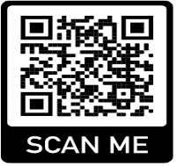
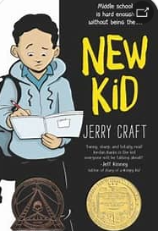
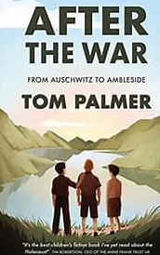
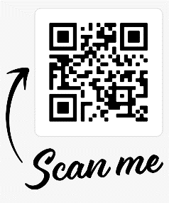
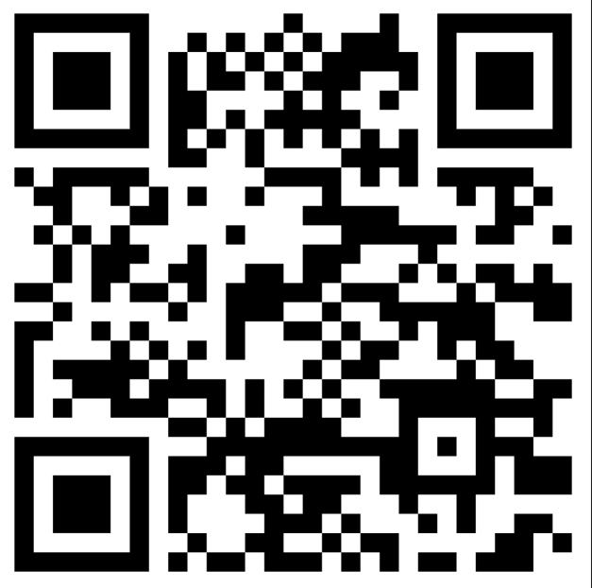
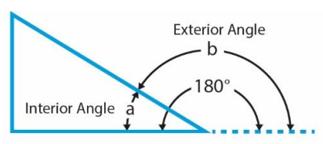
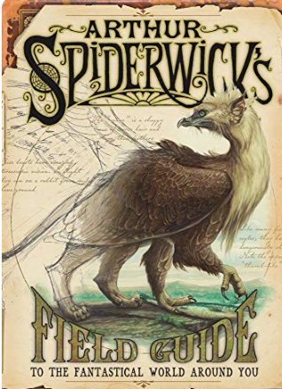
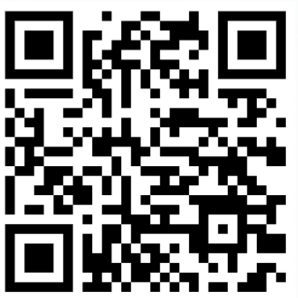
Year 6 Knowledge Map - Lent 1 - 2025
Our class novel is …
St Kizito St Francis
English
In English, we will be reading the book ‘Arthur Spiderwick’s Field Guide to the Fantastical World Around Us. The children will be creating a non chronological report in the style of the field guide, about an innovated creature of their own imagining. Children will explore a wide range of vocabulary and use a thesaurus to extend their language. The children will complete the term by writing a balanced argument.
Prime Numbers
A prime number is a whole number greater than 1 that cannot be
exactly divided by any whole number other
than itself and 1 (e.g. 2, 3, 5, 7, 11).
Angles
Angles are all around us. An angle is created when two straight lines
meet.
An angle less than 90° is acute.
An angle between 90° and 180° is obtuse.
An angle greater than 180° and less than 360° is reflex.
An angle of exactly 90° is a right-angle.
PGL
Year 6 will be embarking on a residential trip to PGL, where they will take part in a variety of activities which will help further their independence and celebrate the end of their primary education. This will take part on
Wednesday 4th June – Friday 6th June.
How can we make our writing more interesting?
Use a variety of sentence lengths.
Include a range of clauses
Use outstanding vocabulary
Vary your sentence openers
Use imagery, metaphor, personification and similes
Use the QR to learn more about rules for adding prefixes and suffixes to root words.
Virtues and themes for Lent 1 are Friendship, Love of Neighbour and Self Control
PSHE/RSE Healthy Relationships When a conflict gets out of
hand, it can help to involve a trusted adult. Sometimes people disagree because our brains process information differently from each other. Children will develop ideas on how to build resilience through thankfulness, use simplified CBT( Cognitive Behaviour Therapy ) techniques to manage their thoughts, feelings and actions and cope with new or difficult feelings such as romance and rage.
RE- Galilee to Jerusalem
In this unit, children will explore the Gospel of John: - from The Prologue and First Miracle through The Second and Third Miracles to the ‘I am Statements’ . Children will use theological vocabulary to explain what Catholics believe about Jesus’
Learn these spellings and try to include them in your written work
malevolent | supernatural | terrifying
forbidding | peculiar | fearsome
fundamentally | benevolent | nuisance
physical | fascinating | immediately
stomach | moreover | temperature
Dates
6th January - Epiphany of the Lord
14th February - Ash Wednesday

Slide 2
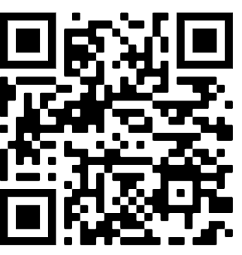
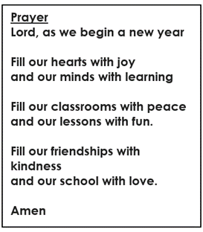
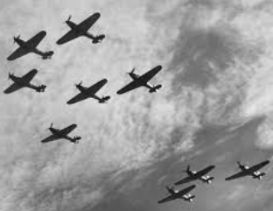
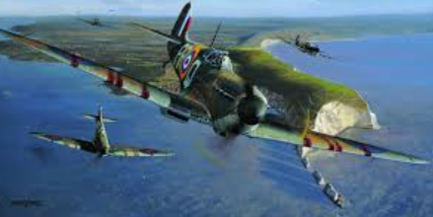
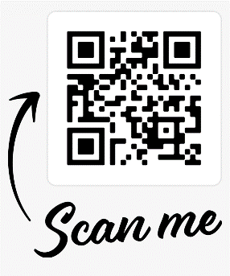
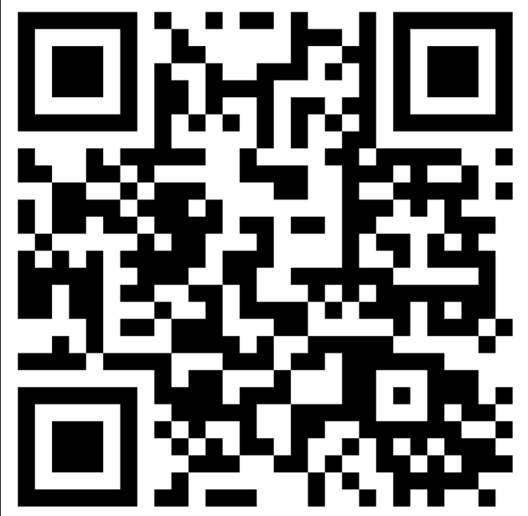
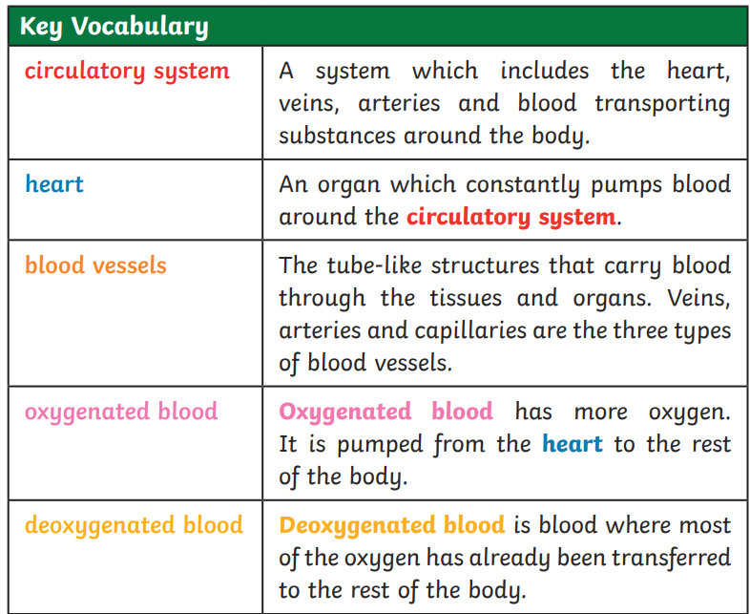
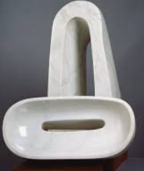
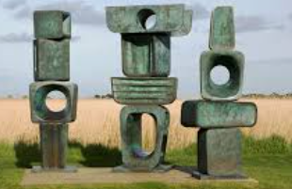
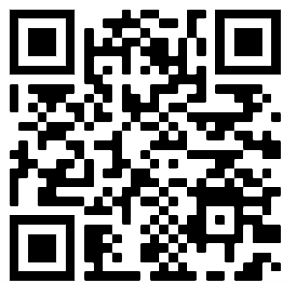
Year 6 Knowledge Map – Lent 1 - 2025
History - Battle of Britain
World War 2 was a battle between two groups of countries – the ‘Allies’ and the ‘Axis’. The major Allied powers were Britain, France, Russia, China and the United States. The major Axis powers were Germany, Italy and Japan. Adolf Hitler, together with the Nazi Party, wanted Germany to rule Europe.
To gain more land and power, on 1 September 1939 German troops invaded Poland. After Hitler refused to stop the invasion, Britain and France declared war on Germany – World War II had begun. During the course of the war, German forces advanced through Europe. By the summer of 1941 they had invaded France, Belgium, Holland, Luxembourg, Denmark, Norway, Greece, Yugoslavia and the USSR. Life changed dramatically for Britons during the war. World War 2 officially ended on 2nd September 1945.
Science -Animals including Humans: Healthy Bodies
The main parts of the circulatory system are the heart, veins, arteries and blood vessels.
The main functions of the heart, lungs and blood vessels are to transport substances around the body.
The digestive system breaks down nutrients using glands in your stomach.
lining which make stomach acid and enzymes that break down food.
Muscles of your stomach mix the food with these digestive juices.
Pancreas. Your pancreas makes a digestive juice that has enzymes.
that break down carbohydrates, fats, and proteins.
The 5 Key Elements to a Healthy Lifestyle are:
A Balanced Diet. A balanced diet is easier and more beneficial than
a low-fat or low-carbohydrate diet for most people to maintain;
2) Regular physical activity;
3) Maintaining a regular sleep pattern;
Managing stress;
Using supplementation.
Scan Me!
Art - Barbara Hepworth
Barbara Hepworth (born January 10, 1903,Wakefield, Yorkshire, England—died May 20, 1975, St. Ives, Cornwall) was a sculptor whose works were among the earliest abstract sculptures produced in England. Her lyrical forms and feeling for material made her one of the most influential sculptors of the mid-20th century. Pupils will be manipulating clay to create patterns, tone and mark make to produce an abstract sculpture.
MFL – Pupils will be learning how to articulate their daily weekday routine . Pupils will also discuss in French what they have had for breakfast and compare a typical British Breakfast with a French Breakfast.
PE - PE on Thursdays , come to school dressed in your PE kit. Please wear black joggers, maroon PE shorts and a white T-shirt. This half term Year 6 will be focusing on gymnastics and dance/fitness. Pupils will continue to work on developing their motor skills and working as a team.

