Slide 1
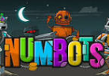
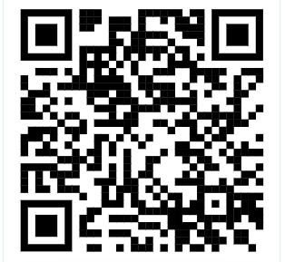
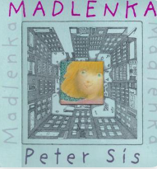
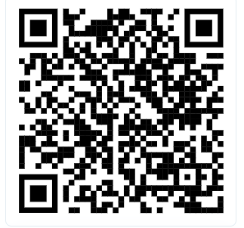
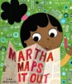
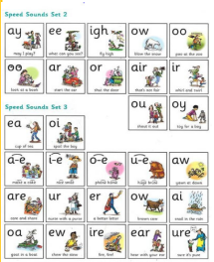
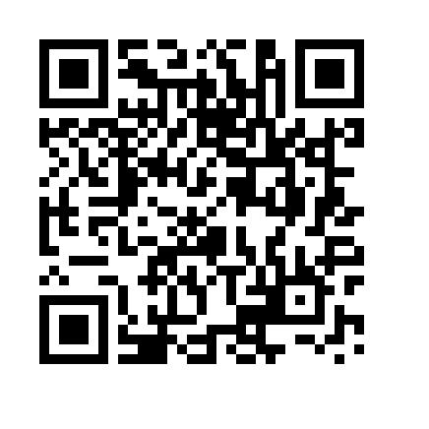
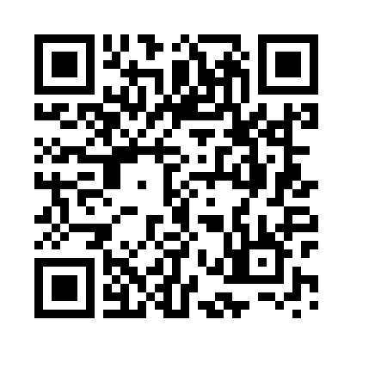
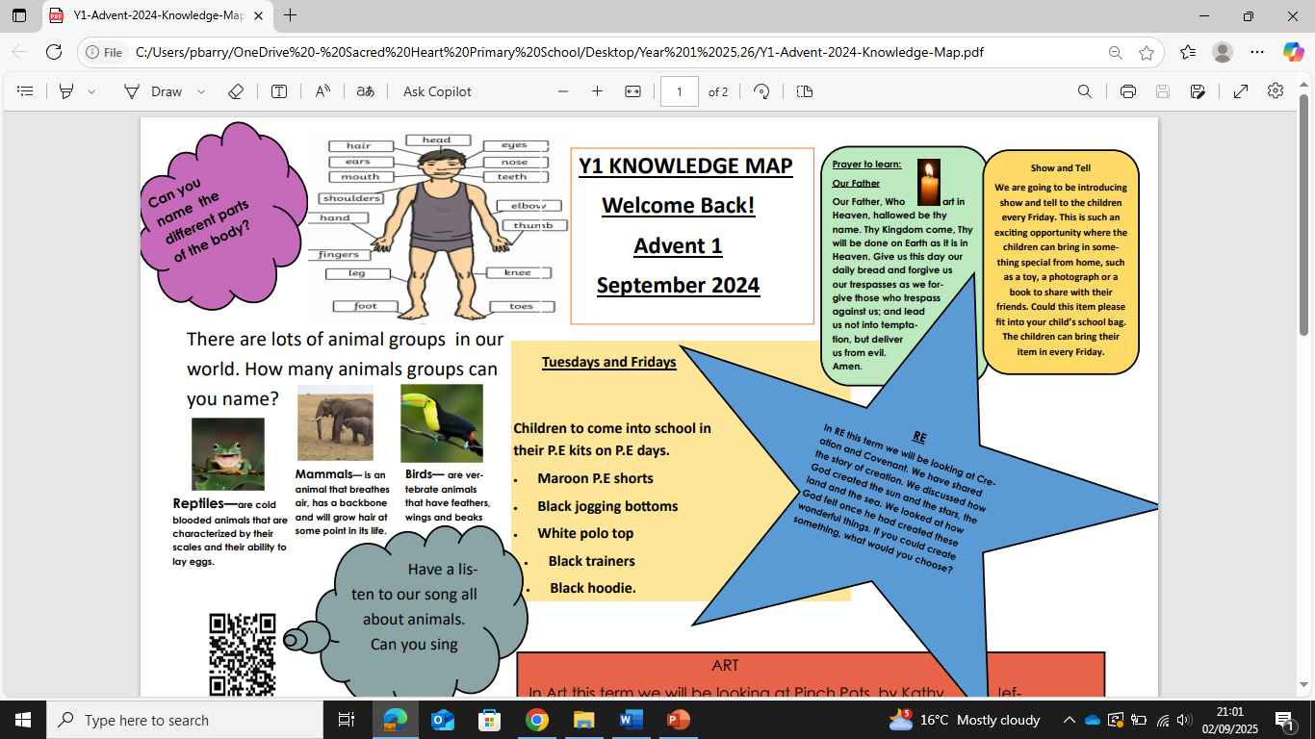
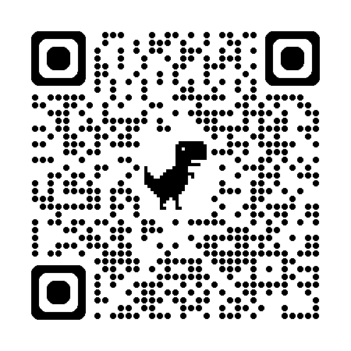
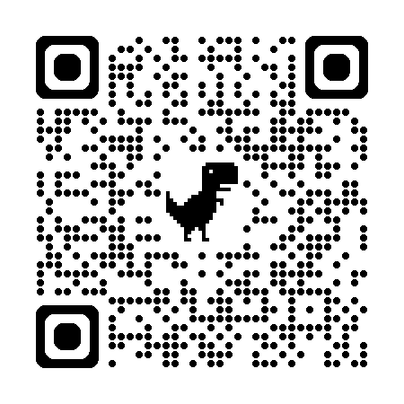
Maths
We will be learning about –
Adding and subtracting
Measures – coins
Counting in 2s, 5s and 10s
Measures – volume, length and mass
Don’t forget to use Numbots at home to support your number work!
Click on the QR code!
Year 1 Knowledge Map
Spring 2 2026
English
This term we will be learning to compose sentences using a capital letter, finger space and full stop. We will begin to use the pronoun ‘I’ and capital letters for people’s names and places. We will also learn about regular plural noun suffixes -s (for example dog, dogs; wish, wishes).
Here are the exciting texts that we are exploring this term!
‘Madlanka’ by Peter Sis - A beautifully illustrated, imaginative story about a young girl in New York City who turns a simple walk around the block to show off her loose tooth into a journey around the world. She visits diverse neighbours, including a French baker and an Indian news vendor, experiencing different cultures through detailed and interactive pages.
Watch me! Click on
the QR code!
‘Martha Maps it Out’ by Leigh Hodgkinson - Martha LOVES drawing maps. She creates maps of everything, from outer space to her little (but very exciting) bedroom! This entertaining and charming book takes you on a journey through her world, filled with, thoughts, dreams, and lots of fun details to spot.
Key Dates
Stockwood Park Trip- 3.3.25
Parent Consultation – 17.3.26
Easter crafts and songs 17.3.26
Lenten Prayer
Loving God,
As we begin our Lenten journey, help us to walk with Jesus every day.
Open our hearts to listen to Your word.
Guide our hands to do kind and loving things.
Fill our minds with thoughts that bring peace.
May our prayers, our choices, and our actions bring us closer to You and closer to one another.
Sacred Heart of Jesus
I place all my trust in you.
Amen.
Phonics
Your child will be taking the Phonic Screening Test in June and are preparing for this at school. We are learning our 3 sounds. Please practice the set 3 sounds using the QR codes sent home. If you need another copy of this please let us know!
Click on the QR code
For the ‘ea’ sound!
Oxford Reading Owl
Don’t forget to login to access
Oxford Reading Owl to
support reading at home.
Mental health and
well being
Breathing techniques
to help children
with self regulation.
RSE
Created to Love Others explores our relationship with others. Children will learn that God loves them. We will learn about special people in our lives and how we treat others well and the times that we need to say sorry. This links to our school virtue which includes being respectful towards people. We will also cover real life online.

Slide 2
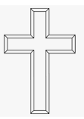
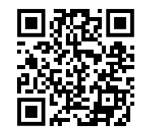
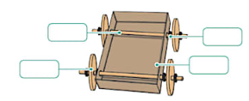
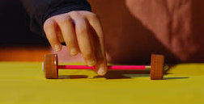
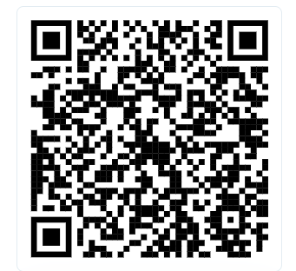
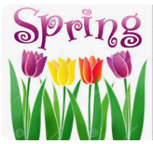
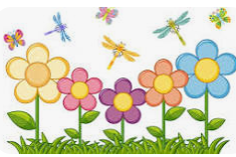
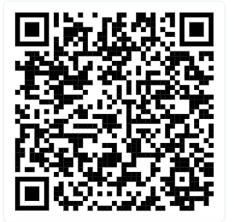
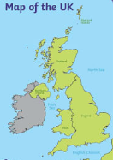
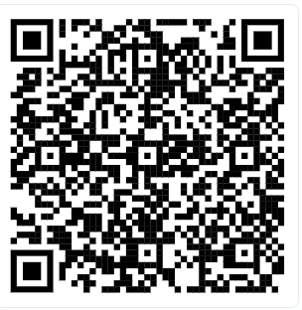


RE
In R.E we will be learning about preparations for Easter. The children will learn about Ash Wednesday and Palm Sunday. They will think of their own Lenten promises and we will begin to look at the Easter story.
Watch the video to find out
more about Ash Wednesday.
Design and Technology
In DT we will be learning about moving vehicles. We will learn what a mechanism is and how it works. Children will be able to identify why we need wheels on cars/bikes etc. Children will then design and create their own moving vehicle with using 4 wheels and 2 rods which is very exciting!
Click the QR code to find out more about mechanisms!
Key vocabulary -mechanism, axel, chassis, wheel, moving, turning
Science
We will be learning about seasonal changes during spring. Children will observe the signs of spring that they can see around them during a walk around our school. We will be discussing how spring impacts different animals, plants and trees.
Key vocabulary: spring, changes, buds, blossoms, hibernation
Geography
In geography, we will be learning that the UK is made up of 4 countries – England, Wales, Scotland and Northern Ireland. We will be looking at maps and how to use them which is a lovely link to the texts that we will be using in English. Children will also know that you have to take different modes of transport to travel to different places.
Click on the QR code to explore the UK!
Watch me to find
out more about spring!
Music
PE
In PE lessons, we will be focusing on developing athletic skills (running, changing speed and direction, jumping and throwing) and playing net and wall games. This includes tennis where children will learn to throw, catch and hit a ball. In PE lessons children will learn to work collaboratively with a partner and in a team to develop social skills and resilience.
In Music we will learning to sing a song called Round and Round by Joanna Mangona. It is a song that was specially written for classroom use to teach children about different musical dimensions. It's style is a Latin Bossa Nova. We will be learning about pulse, rhythm and how to sing the song!

